Slide 1
The Skeletal System
Unit 3- Coordination

Slide 2
Welcome back!
Hope you had a great holidays
Everything will be put on Connect as we go
EST this year
Only 8 assessments including the EST though?

Slide 3
From the curriculum
Skeletal system the support and movement of the body is facilitated by the structure and function of the bones and joints in the skeletal system the location and structure of joints in the skeleton allow for a range of movement the structure and development of long bones provide for strength, growth and repair | 1 | function of the skeleton structure of the bone bones and joints in the skeletal system structure and types of joints
 | 2 | movement at a joint structure of long bones development of long bones how long bones provide for strength, growth and repair

Slide 4
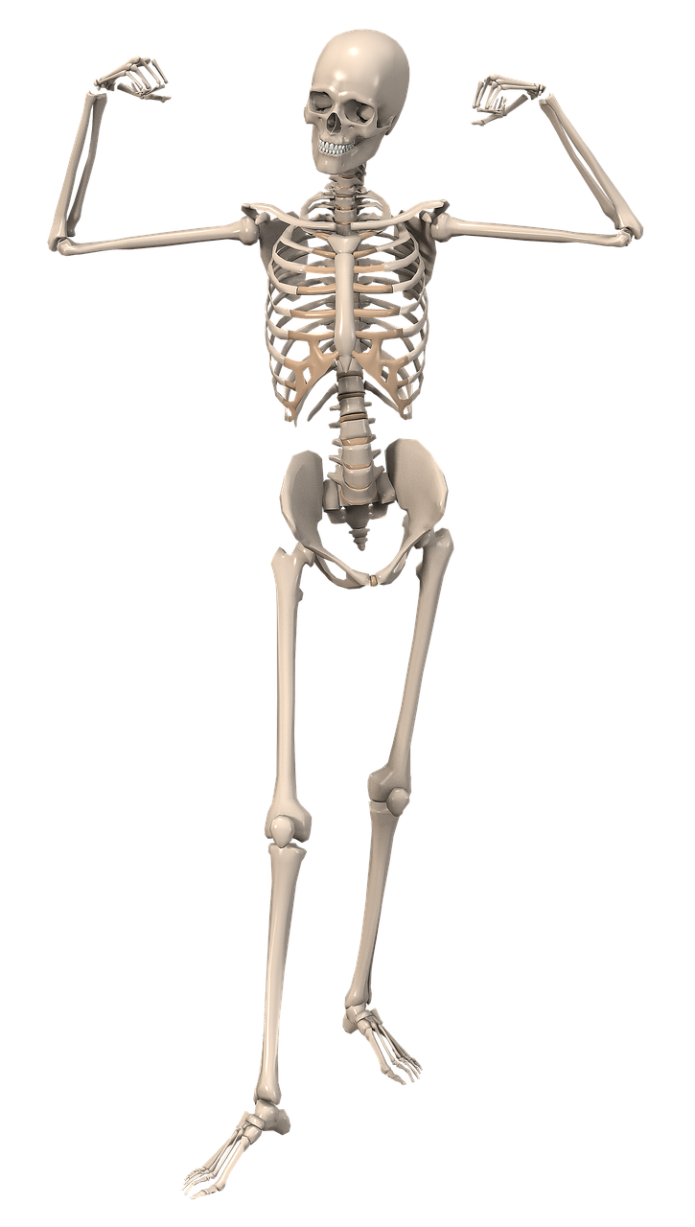
Overview of the skeleton
Skeleton gives shape and form to the body and prevents the soft tissues from collapsing in a heap.
Muscles attached to the bones are able to move them or hold them steady enabling us to stand erect, walk, run, jump and perform complicated movements.

Slide 5
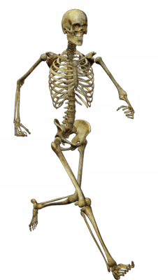
Functions of the skeleton
The skeleton provides a firm framework that gives shape to the body and supports its parts.
The bones that makeup the skeletal system also provide points of attachment for most of the muscles of the body.
When muscles contract, they allow movement to take place. Where bones meet in such a way that they are able to move relative to one another, they are said to articulate. Articulation allows varying degrees of movement depending on the bones involved, so the skeleton determines the extent of movement of body parts.

Slide 6
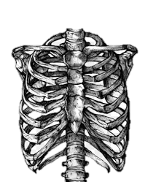
Continued
Another important function of the skeletal system is the protection of vital organs.
For example, brain the is encased within the skull, the spinal cord is contained within the spinal canal formed by the vertebrae, the heart and lungs are protected by the rib cage, and the pelvis protects the internal reproductive organs and bladder.

Slide 7
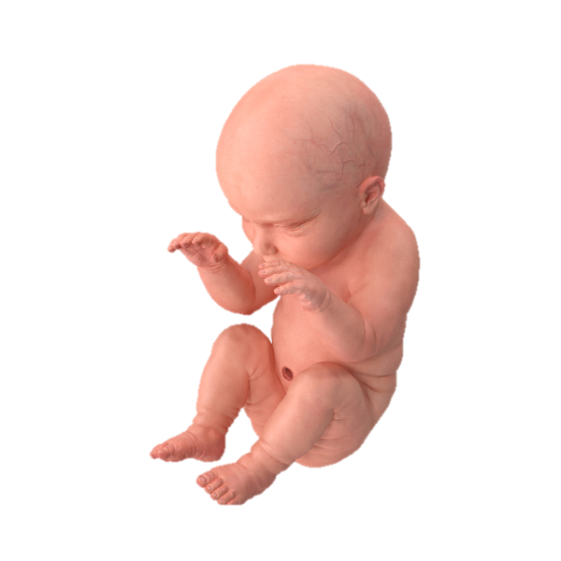
Continued
The bones of the skeleton act as storage organs for mineral salts and fat.
Calcium, phosphorus, sodium and potassium are the main minerals stored within bone.
These can be distributed to other regions of the body by the circulatory system when required.
For example, if a pregnant woman’s diet does not contain enough calcium, it can be removed from her skeleton and used for the growth of bones in the developing foetus.

Slide 8
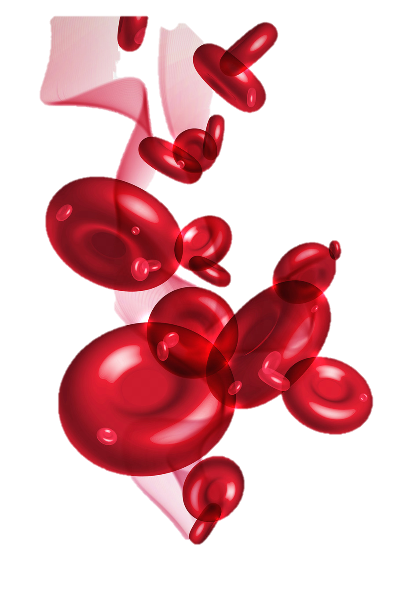
Continued
Finally, the skeleton has a role in blood cell production.
The red marrow contains certain bones contains stem cells that can differentiate into blood cells.
Factors in cells’ environment determines whether they become red cells, white cells or platelets.

Slide 9
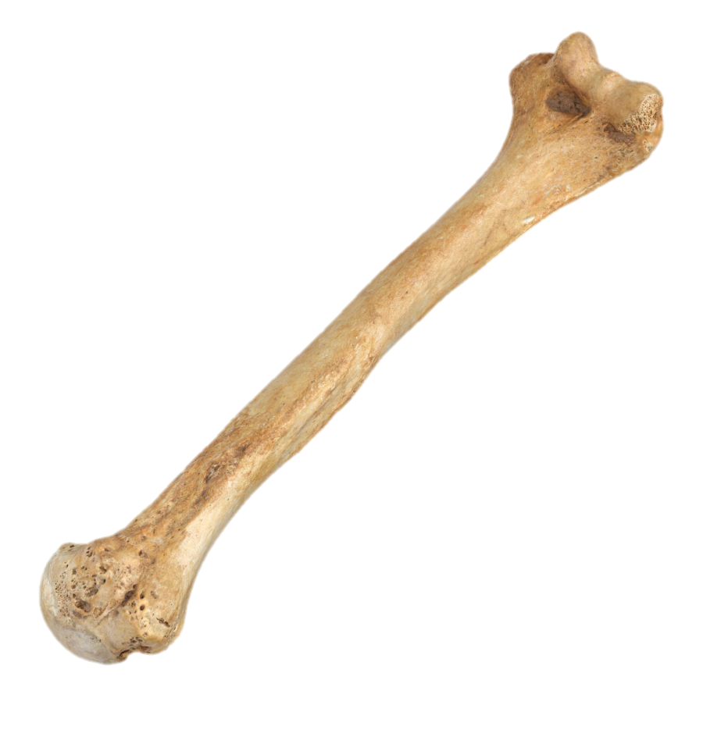
Structure Of bone
Bones are actually living organs containing living cells and are capable of growth and repair.

Slide 10
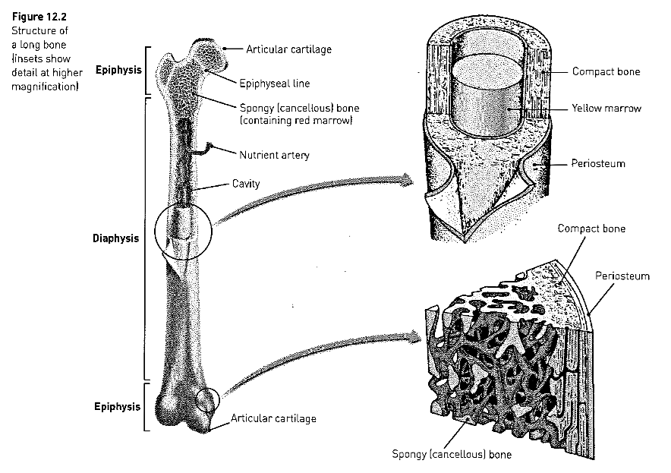
Shows a typical long bone, such as the upper arm bone.
A long bone consists of:
A shaft, called the diaphysis, making up the main portion of the bone
the ends, or epiphyses (singular, epiphysis), which are the enlarged ends of the bone; a thin layer of cartilage, the articular cartilage, covers each epiphysis.

Slide 11
Continued
When the bone is cut lengthwise, the diaphysis is seen to be a hollow cylinder of compact surrounding a cavity.
This cavity is used as a fat storage site and is often called the yellow bone marrow cavity.

Slide 12
Continued
The epiphyses have compact bone on the outside but their central regions contain spongy or cancellous bone.
Cancellous bone is more porous than compact bone, and contains many large spaces filled with marrow.
In certain bones this may be red bone marrow, where blood cell production takes place.
On the outer surface of the bone is a dense, white, fibrous covering, the periosteum. There is no periosteum at the joints where the bone is covered with an articular cartilage.

Slide 13
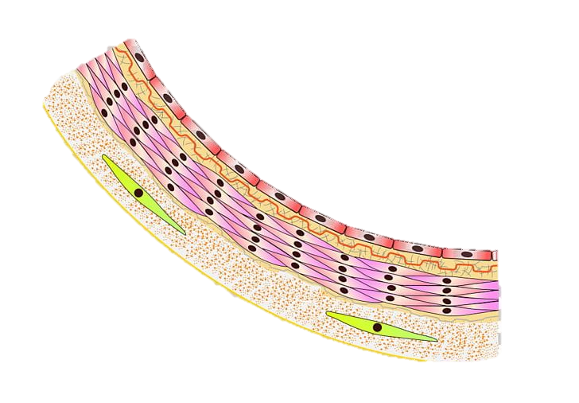
Microscopic structure of bone
Bone is classified as a connective tissue.
Connective tissues consist of cells separated from each other by large amounts of non-cellular material called matrix.
In bone, inorganic salts are deposited in the matrix.
These increase its rigidity and strength and make it the hardest of the connective tissues.

Slide 14
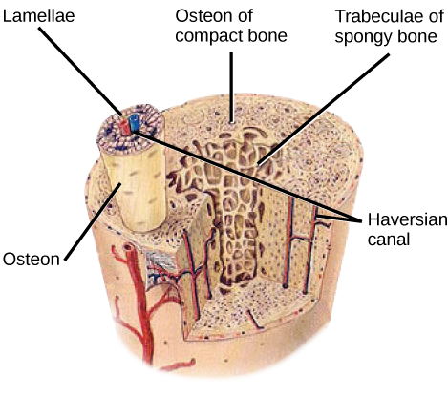
Continued
When thin slices of bone are examined under a microscope, it can be seen to have a very complex structure.
Compact bone consists of many similar units called osteons or Haversian systems.
At the centre of each osteon is a central canal (or Haversian canal), around which are concentric layers of bony matrix called lamellae.

Slide 15
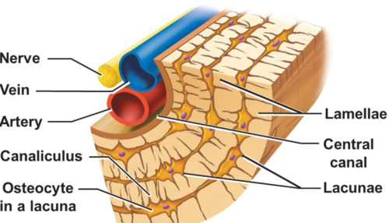
Continued
Between the lamellae are small spaces in the matrix, the lacunae.
A bone cell occupies each lacuna.
Tiny canals, known as canaliculi, run between the lacunae.
Projections from the bone cells enter the canaliculi (tiny canals) and make contact with adjacent bone cells.
In this way, materials can be passed from cell to cell.

Slide 16
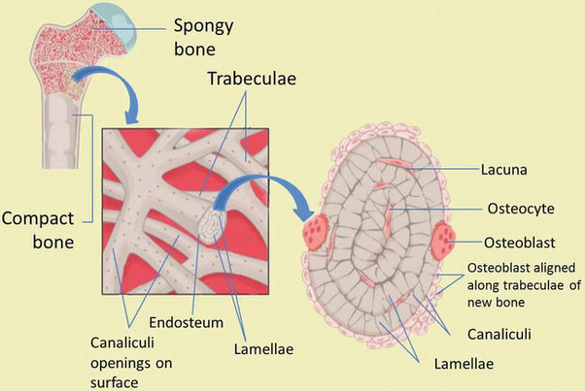

Slide 17
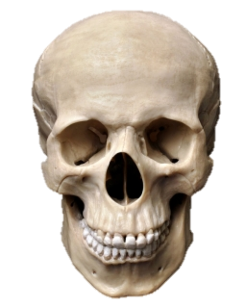
CONTINUED
Bone grows as an individual passes through infancy and adolescence to adulthood.
In an adult, the bones of the skeletal system are capable of repair and continue their functions of blood cell formation an storage.

Slide 18
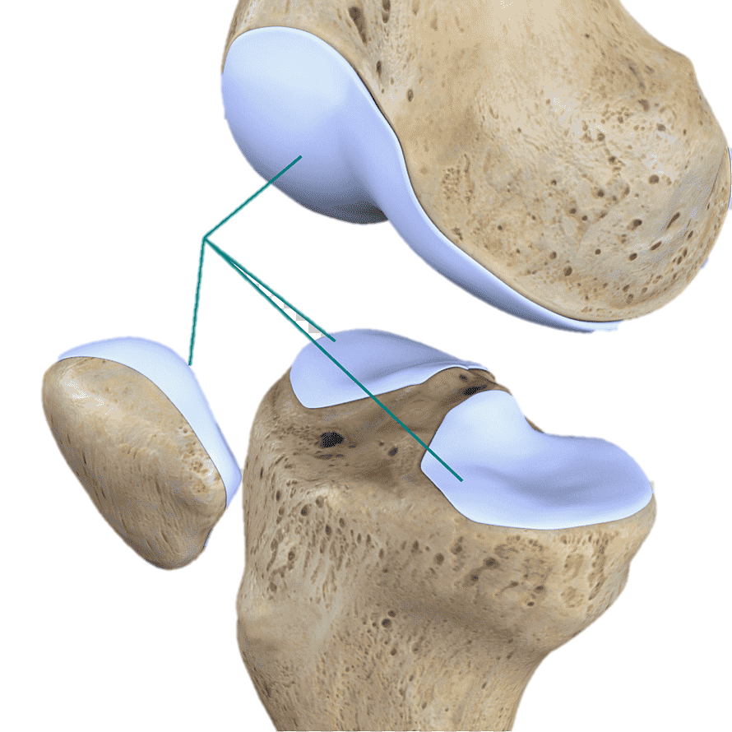
Cartilage
Cartilage is a connective tissue.
Contains fibres made up of a protein called collagen.
The protein fibres are embedded in a matrix for structural support.
It is found on the surface of bones at the joints and in the trachea, bronchi, and forms the nose, larynx and outer ear.

Slide 19
Microscopic structure of cartilage
Within the matrix are spaces that contain cartilage cells.
They produce the matrix until they become surrounded by it and trapped.
When this happens the cells are considered to be mature.

Slide 20
Types of Cartilage
Hyaline: many closely packed fine fibres throughout the matrix. Give cartilage strength along with flexibility.
Makes up rings of the trachea.

Slide 21
Types of cartilage
Elastic: has elastic fibres. Provides flexible elastic support.
Makes up the external ear. Folding down your ear and letting it go shows how springy this cartilage is.

Slide 22
Types of cartilage
Fibrocartilage: coarse appearance from bundles of thick fibres.
Fibres are not compacted and are good at withstanding heavy pressure.
Found in the discs of the spinal column.

Slide 23
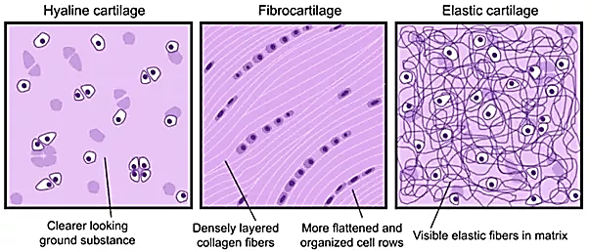

Slide 24
Cartilage continued
Cartilage does not contain blood vessels, so all nutrition and waste removal for the cells depends on diffusion through the matrix.
Slow process and that’s why it takes so long to heal.

Slide 25
Bones and Joints of the skeleton
SEE HANDOUT

Slide 26
Structure of a Synovial Joint
Freely movable joints are also called synovial joints because there is a space, or synovial cavity, between the articulating surfaces of the bones.
A synovial membrane surrounds the synovial cavity, there is articular cartilage on the bone surfaces.
The knee joint, where the femur meets the tibia, is a typical synovial joint.
The patella, or kneecap, is also part of the structure of this joint.

Slide 27
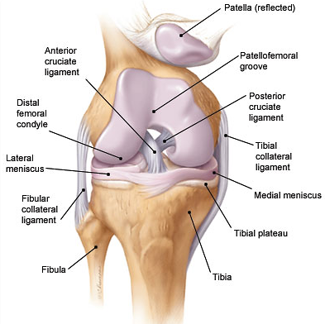

Slide 28
Continued
An articular capsule surrounds and encloses the joint. The capsule comprises two layers.
1. The outer layer, the fibrous capsule, consists of dense, fibrous connective tissue attached the periosteum of the articulating bones. Its flexibility permits movement at the joint, whereas its strength resists dislocation. The fibrous capsule is one of the principal structures that hold the bones together.
2. The synovial membrane makes up the inner layer of the capsule. It consists of loose connective tissue, the inner surface of which is well supplied with blood capillaries. The synovial membrane lines the entire joint cavity, except the articular cartilages and a structure called the articular disc.

Slide 29
Continued
Synovial fluid, secreted by the synovial membrane, fills the synovial cavity. It lubricates the joint and provides nourishment for the cells of the articular cartilage.
Articular cartilage covers the articulating surfaces of the bones forming the joint. This tissue provides a smooth surface for movement.

Slide 30
Continued
Articular discs occur in some synovial joints. They divide the synovial cavity into two. Flow of synovial fluid can then be directed to areas of greatest friction.
Bursae, or little sacs of synovial fluid, are another feature of some joints. These are positioned in such a way as to prevent friction between a bone and a ligament or tendon, or between a bone and the skin, in cases where a bone inside a joint capsule is near the body surface.

Slide 31
Continued
Accessory ligaments hold the bones together in many joints (for example, the ligaments of the knee joint).

Slide 32
Movement at a joint
A number of terms are used to describe the types of movement that may occur at a joint.
- flexion or bending, which usually decreases the angle between the articulating bones (for example, bending the knee or bending the elbow).
- extension or straightening, which usually increases the angle between the articulating bones (for example, straightening of the arm or leg after flexion).

Slide 33
Continued
- Abduction, which is movement away from the midline of the body (for example, lifting the arms upwards and away from the body)
- Adduction, which is movement towards the midline of the body (for example, returning the arms to the sides after abduction).
- Rotation, which is the movement of a bone around its long axis (for example, rotation of the humerus occurs when the palm is turned upwards by twisting the forearm from the shoulder).

Slide 34
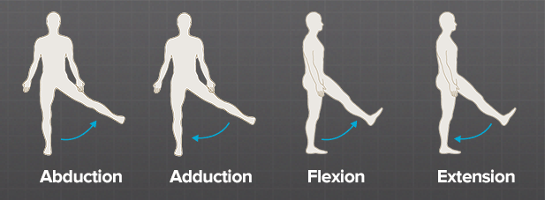
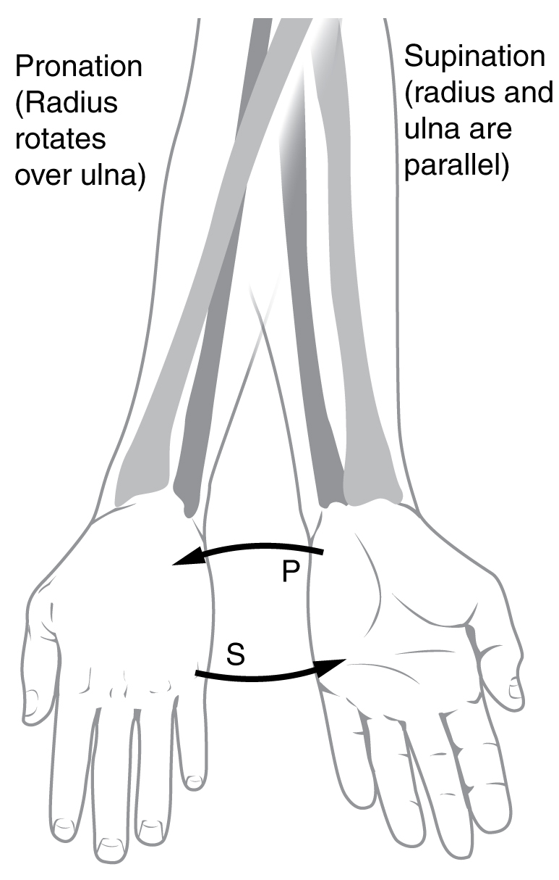
Rotation of the humerus:
1- Palm posterior
2- Palm anterior

Slide 35
Development of long bones
Long bones grow on a template of cartilage, in a process called endochondral ossification.
Initially, the adult stem cells (mesenchymal condensations) differentiate into cartilage, populated by cells called the chondrocytes.
The template then condenses and becomes hypoxic (lack of oxygen) in the middle. This further stimulates the differentiation of the cells and induces secretion of certain molecules which attract blood vessels, and with them, blood forming cells.

Slide 36
Continued
The bone is then laid down on the template of cartilage. The remaining cartilage continues to expand and die, driving the long bone formation.
Later on in development, another event of blood invasion occurs at the end of the bones and a secondary centre of ossification forms.
The cartilage between the two centres of ossification continues to drive the long bone formation until puberty, when its activity seizes and the bone elements fuse together.

Slide 37
How bones provide for strength, growth and repair
Bones provide a firm framework that gives shape to the body and supports its parts.
Bones grow during childhood through to adulthood.
Bones repair themselves when damaged. (Last topic to cover)

Slide 38
Broken bones (repair 101)
Four steps
1) The body forms a blood clot around the broken bone to protect it and deliver the cells needed for healing.
2) Bone generation through collagen fibres that connect the ends of the broken bone and start to form spongy bone.
3) Bony callous formation is when fibrocartilaginous callus is converted to spongy callus. The break is now joined together by new bone.
4) Bone is remodelled by osteoclasts and osteoblasts. Can take months to years.

